Slide 1
Parking System App
Alec Agnese & rami el khatib
Cop 5339-001 group 18

Slide 2
USE CASES
1. Sign Up
2. Log in
3. Add Credits
4. Park
5. Add Vehicle
6. Remove Vehicle
7. Check out
8. Change password
9. Log out

Slide 3

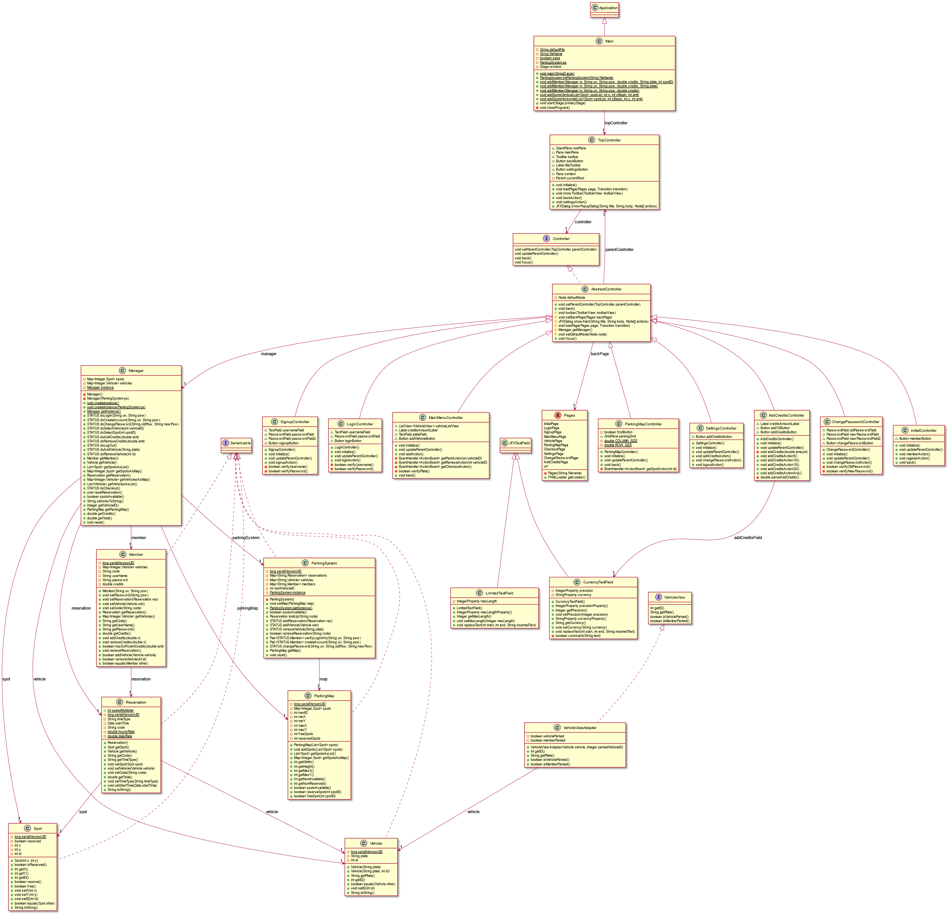



CLASS DIAGRAM

Slide 4
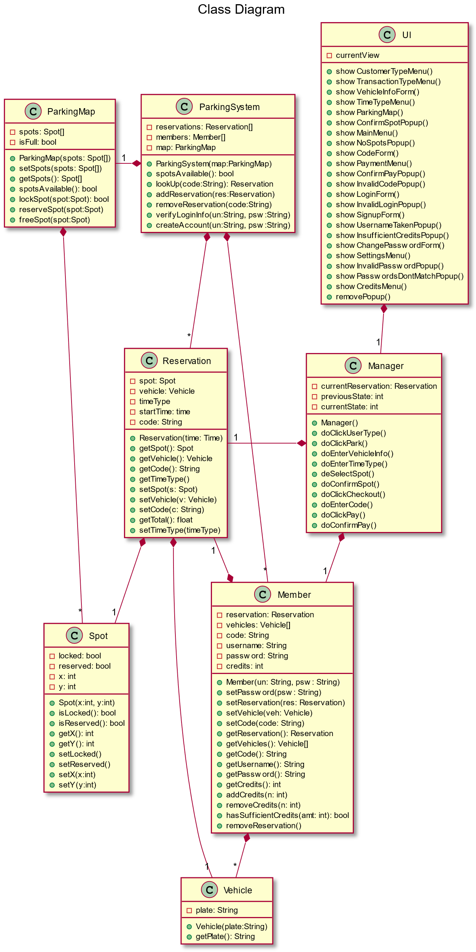
SIMPLIFIED CLASS DIAGRAM

Slide 5

Design Patterns
Façade: Frontend $→$ Manager $→$ Backend
Template: AbstractController $→$ Controller (for each page)
Observer: TopController $→$ AbstractController
Strategy : TopController $→$ Pages
Adapter: Vehicle $→$ VehicleView
Singleton: Manager, ParkingSystem

Slide 6
SEQUENCE DIAGRAMS

Slide 7

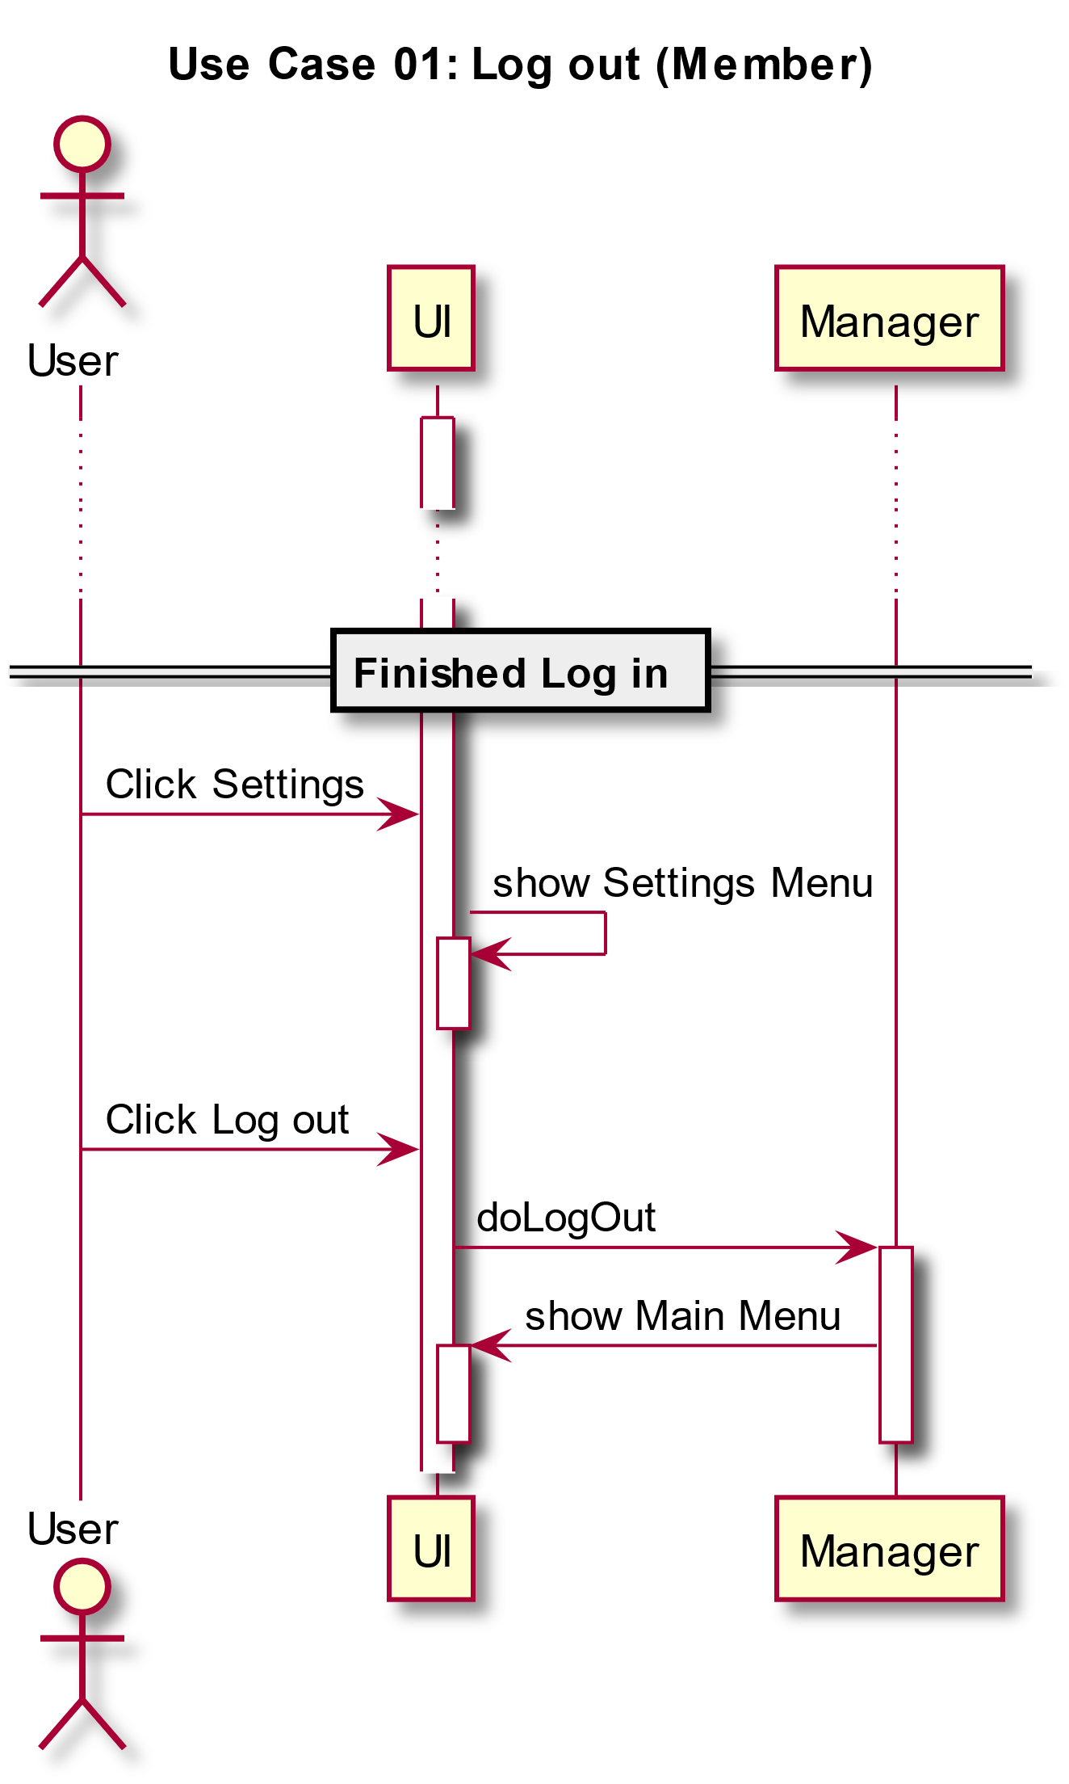

Slide 8
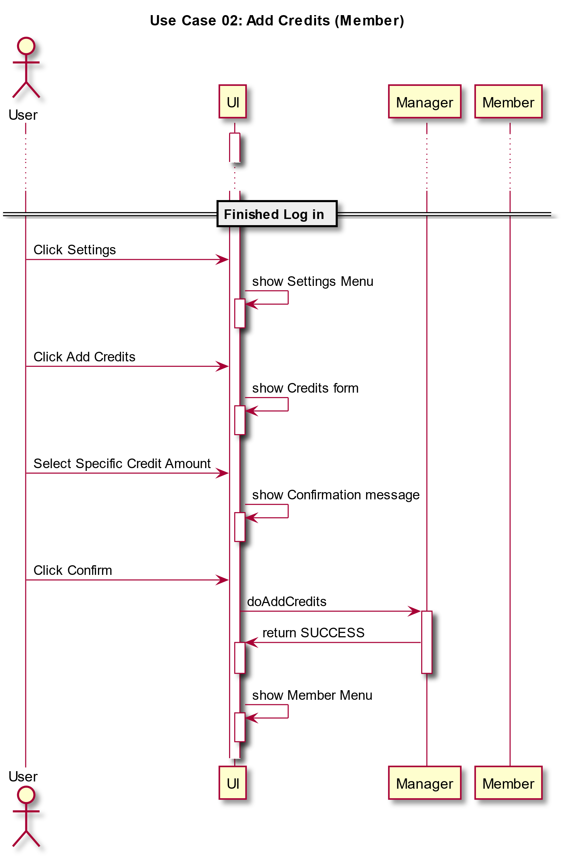

Slide 9
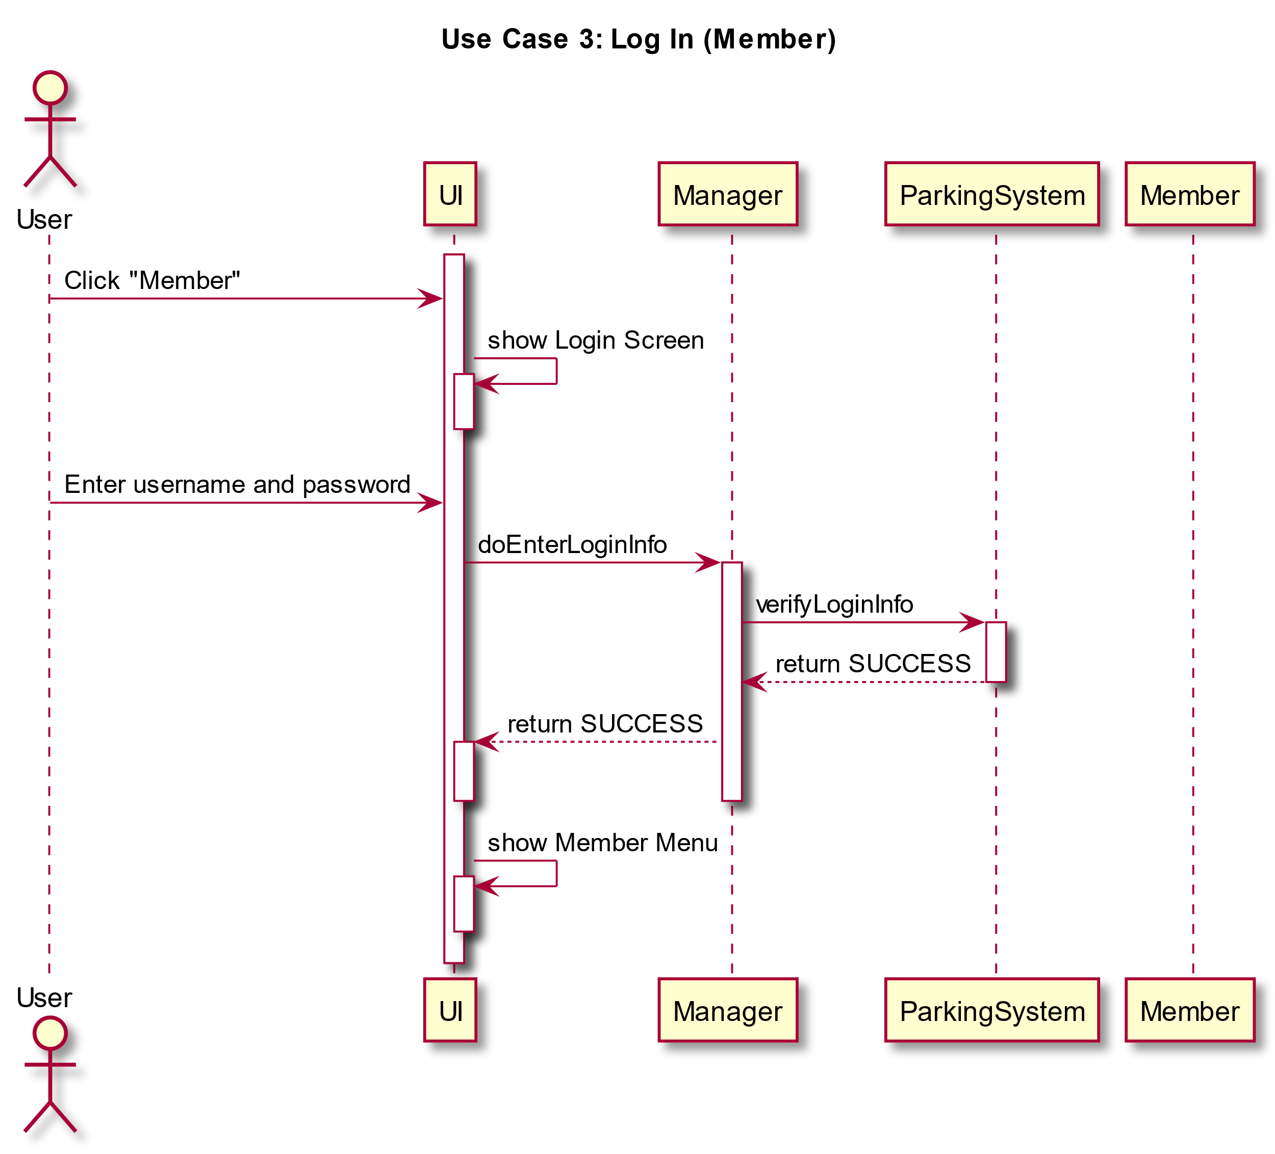

Slide 10
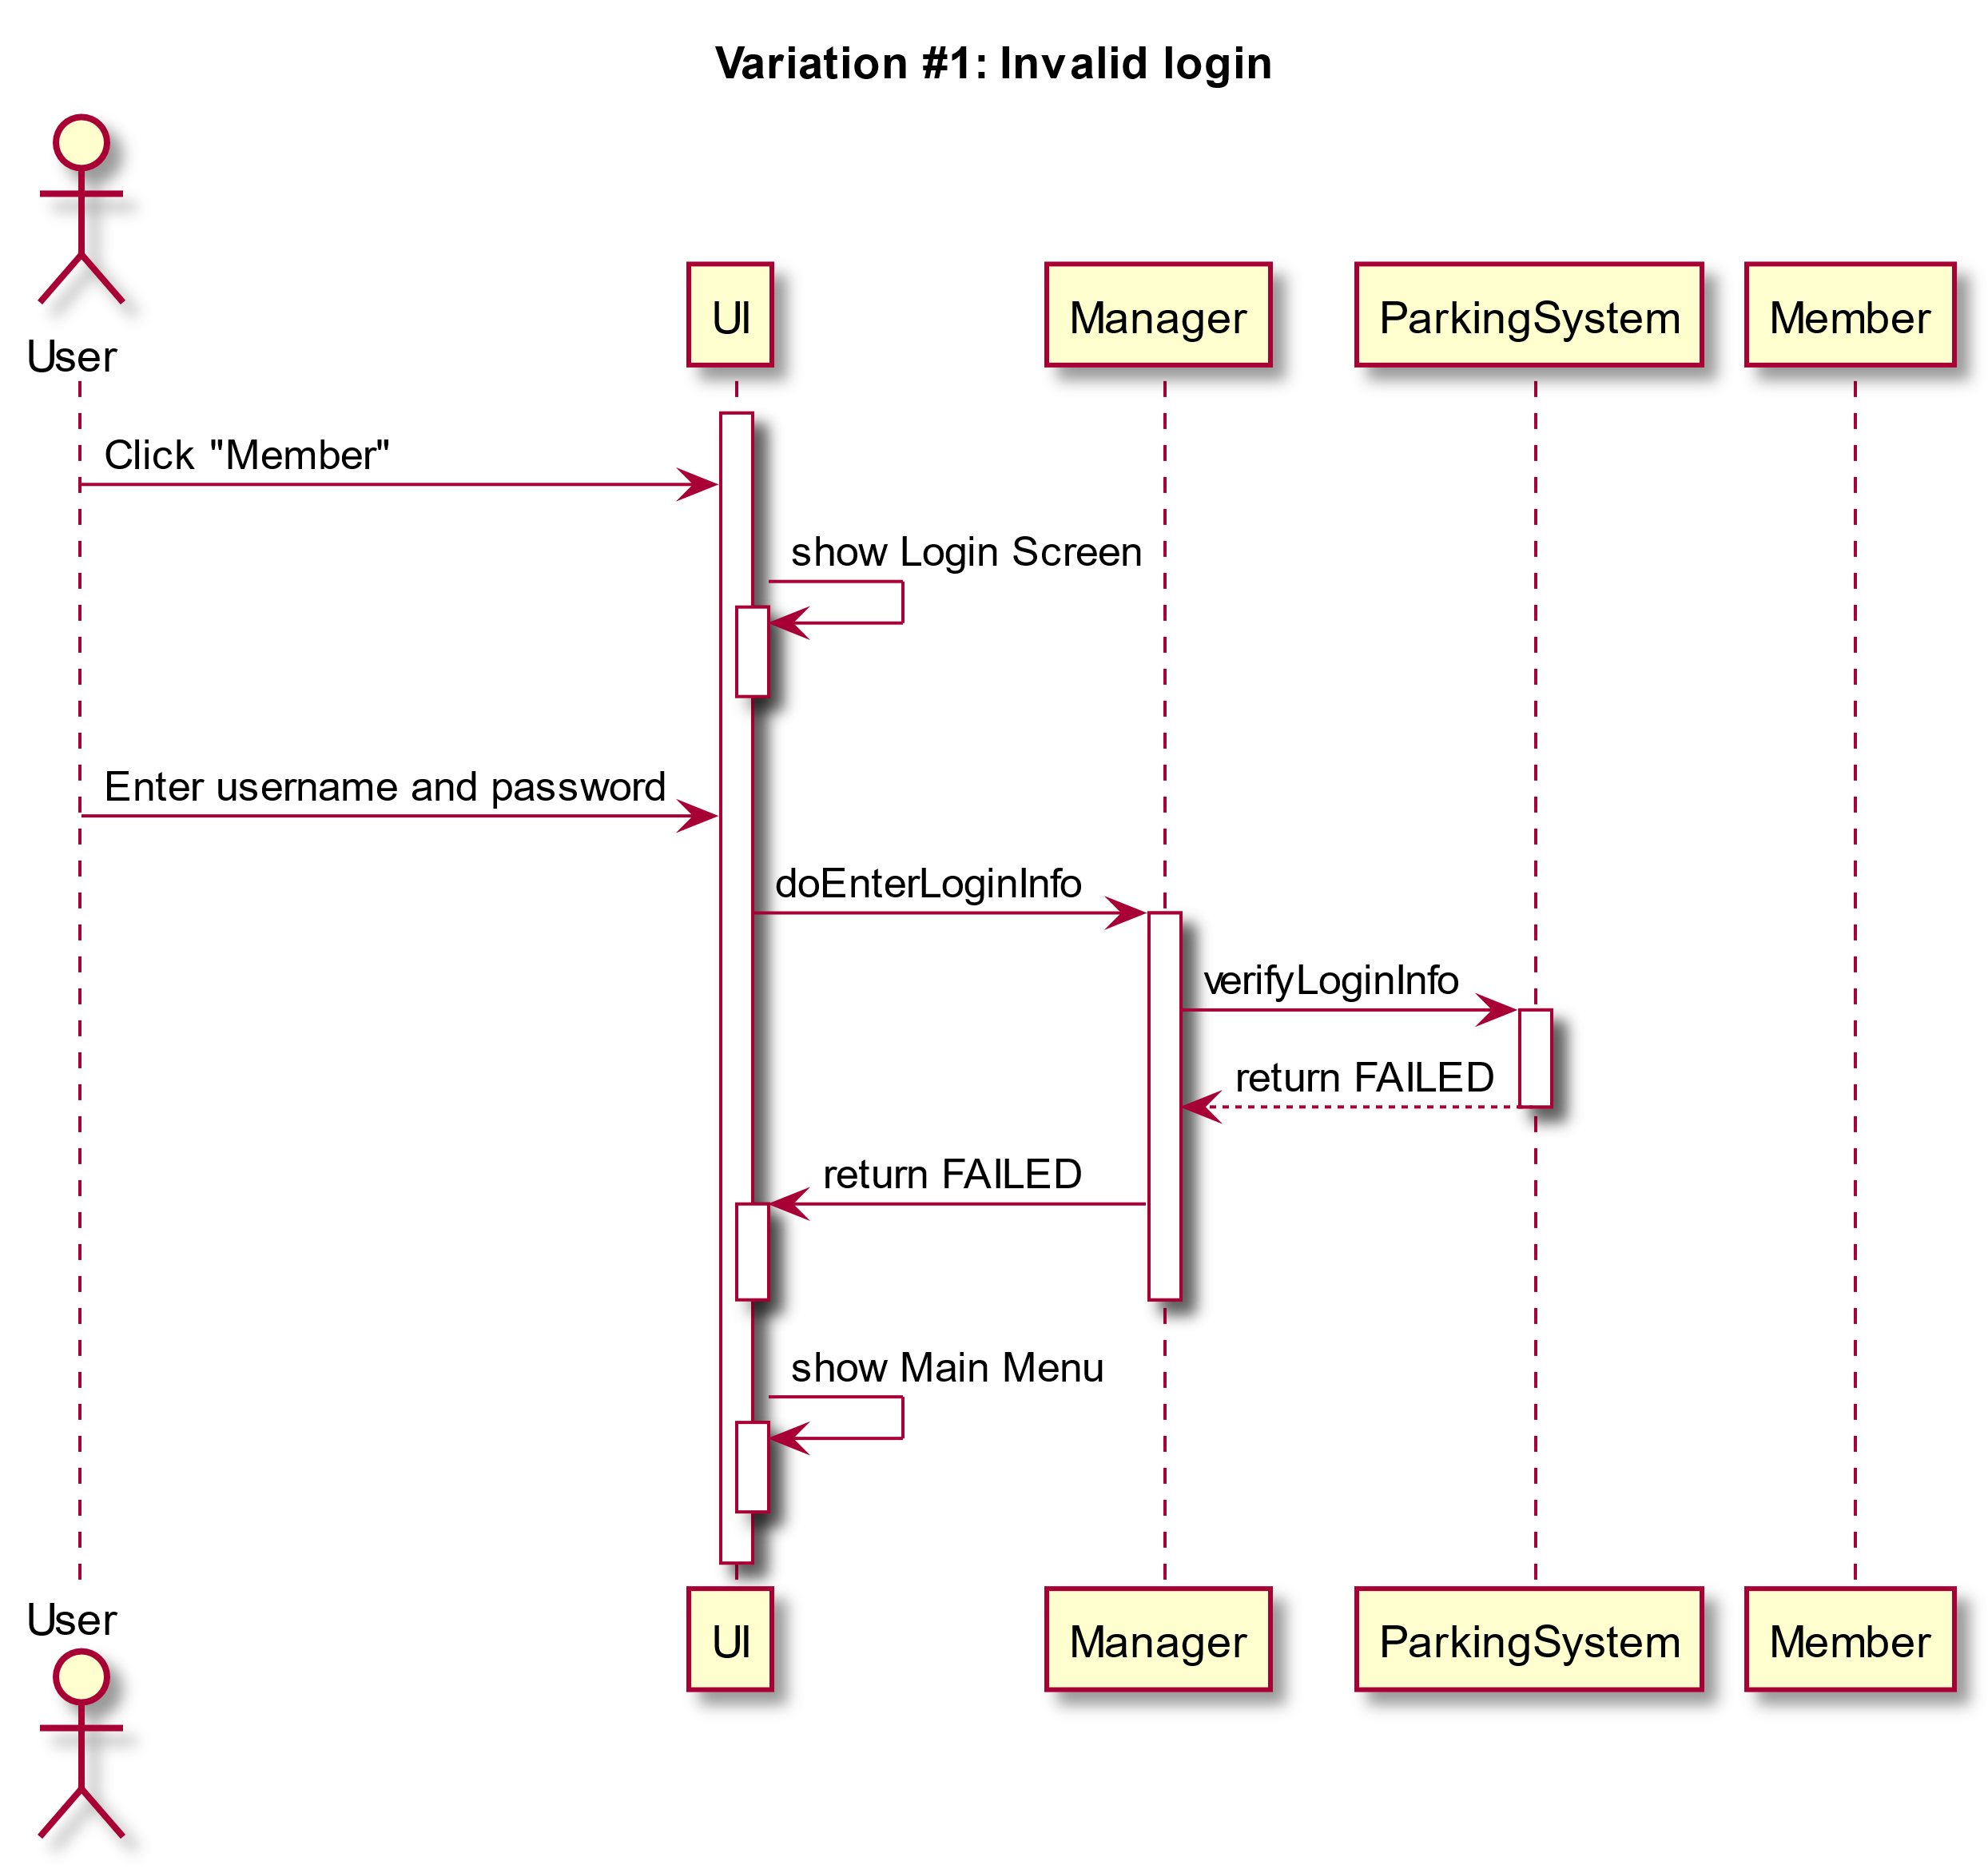

Slide 11
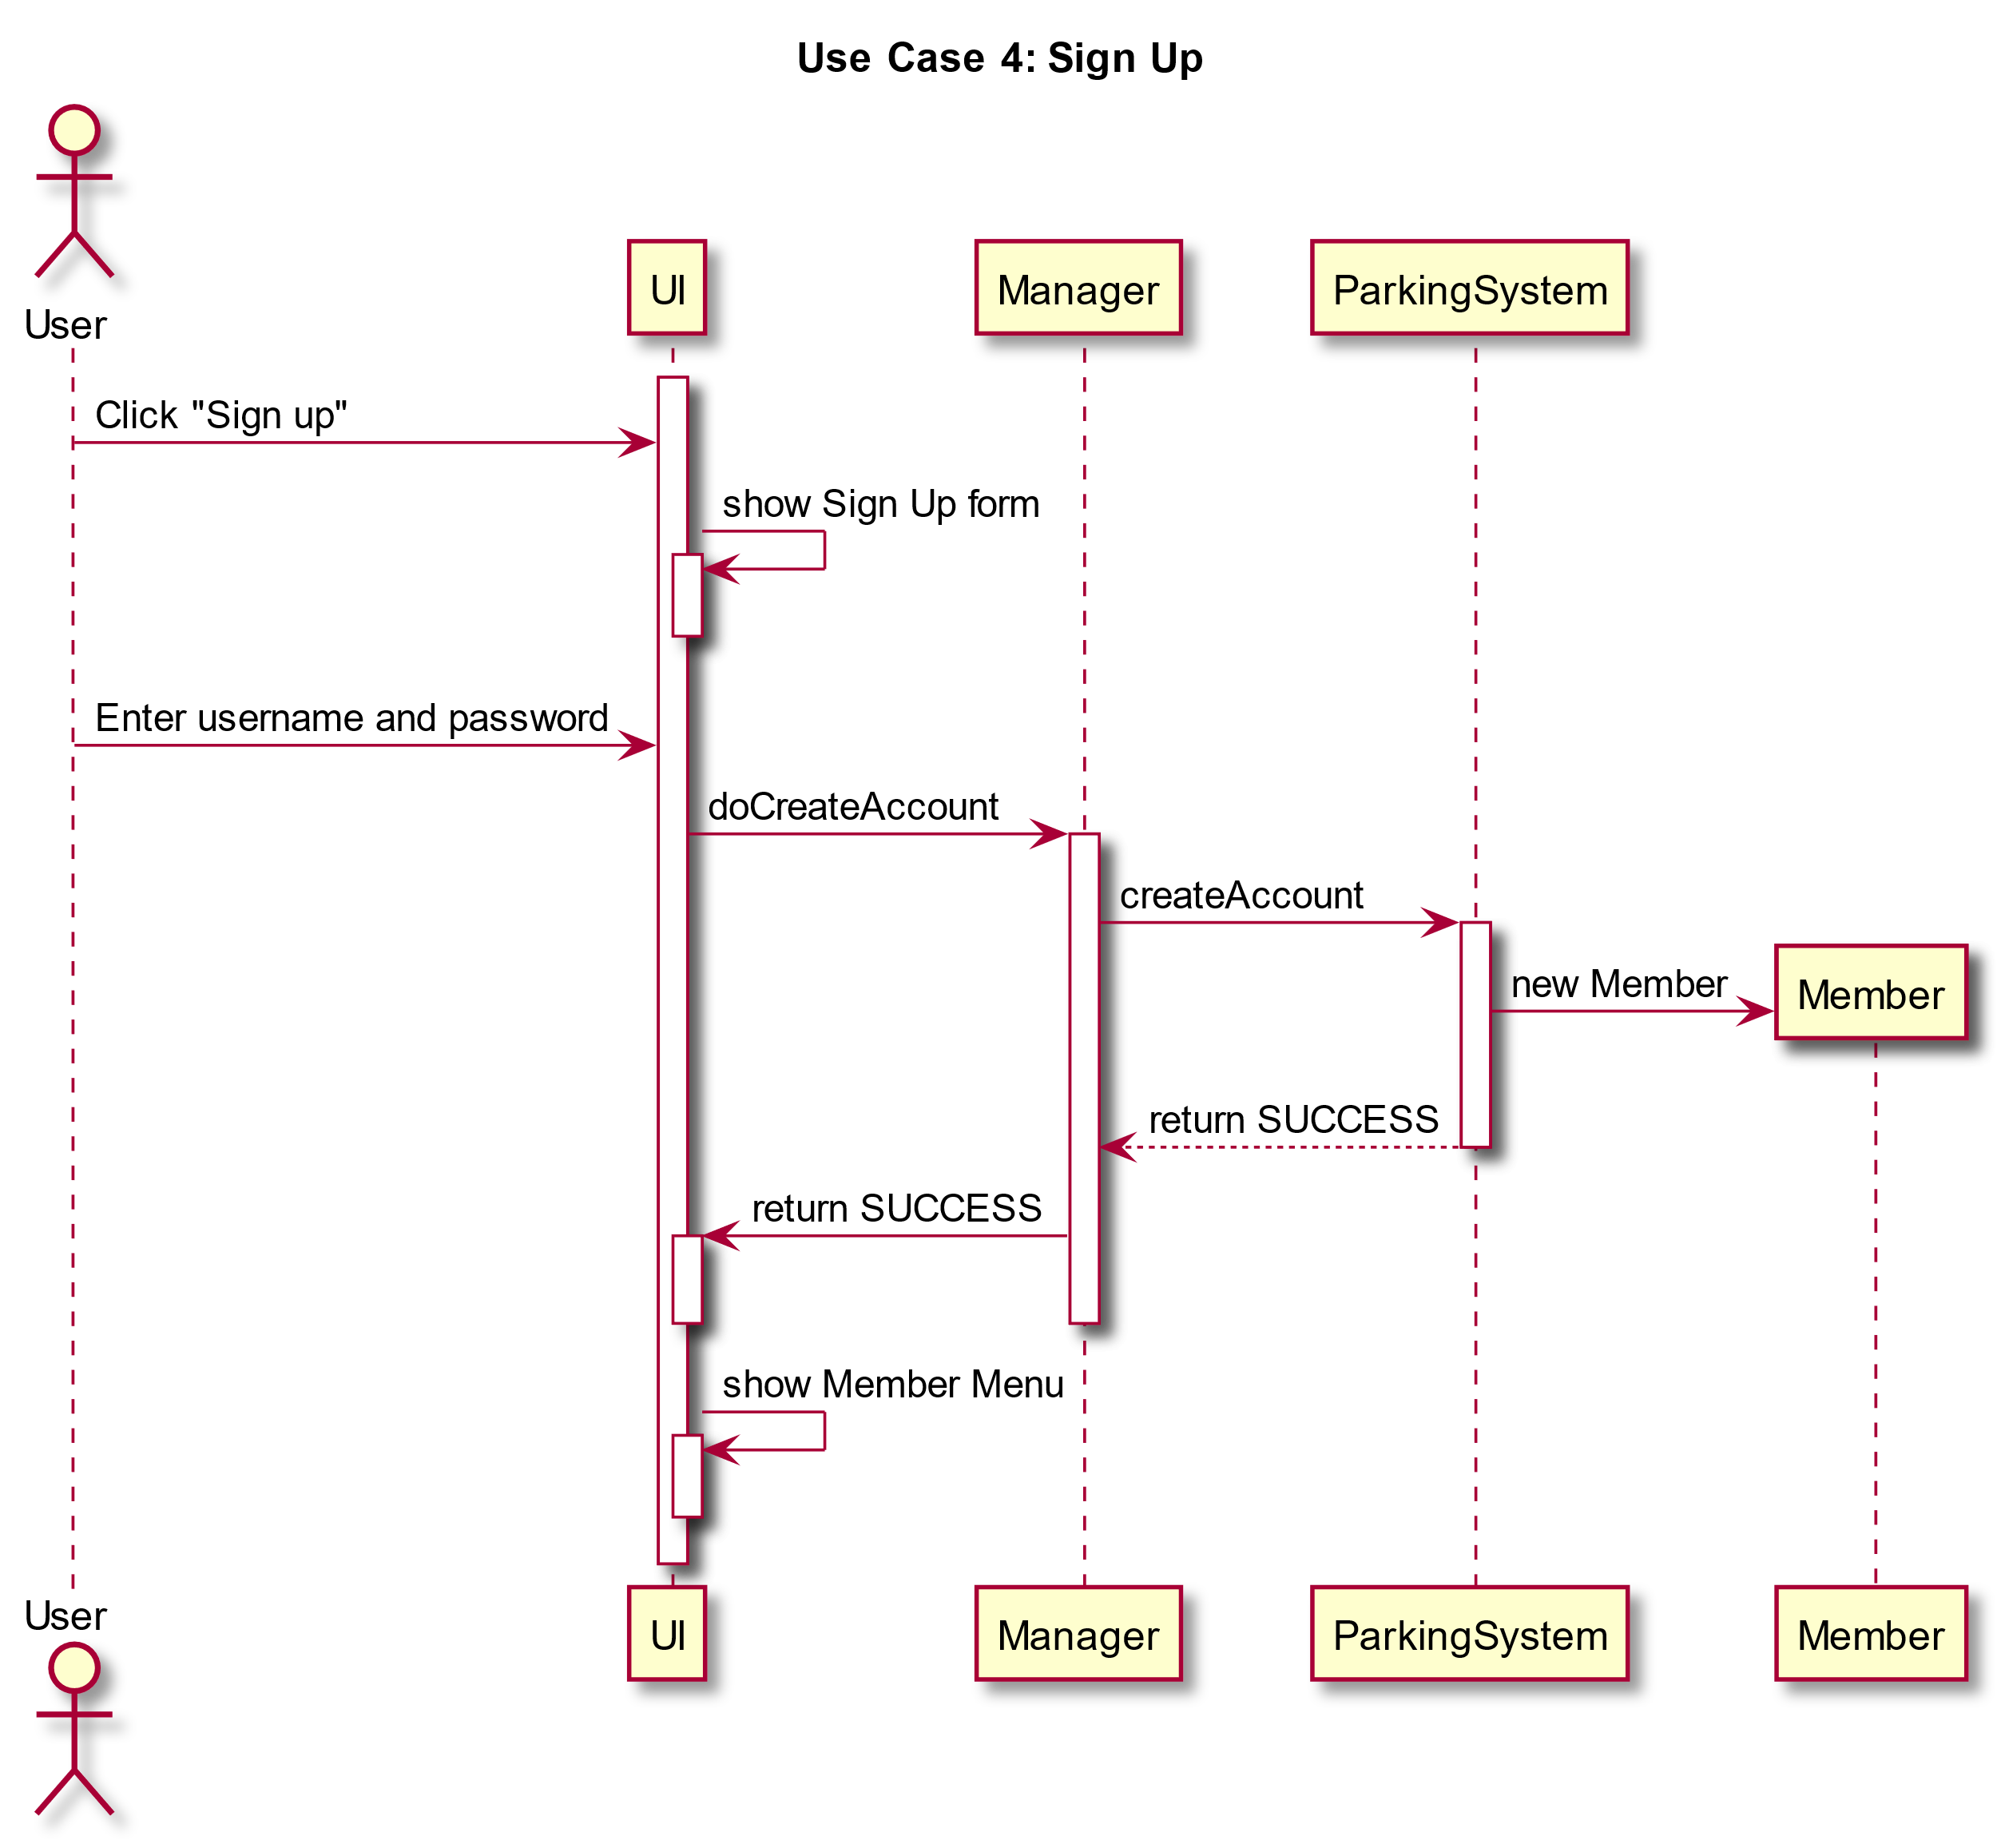

Slide 12
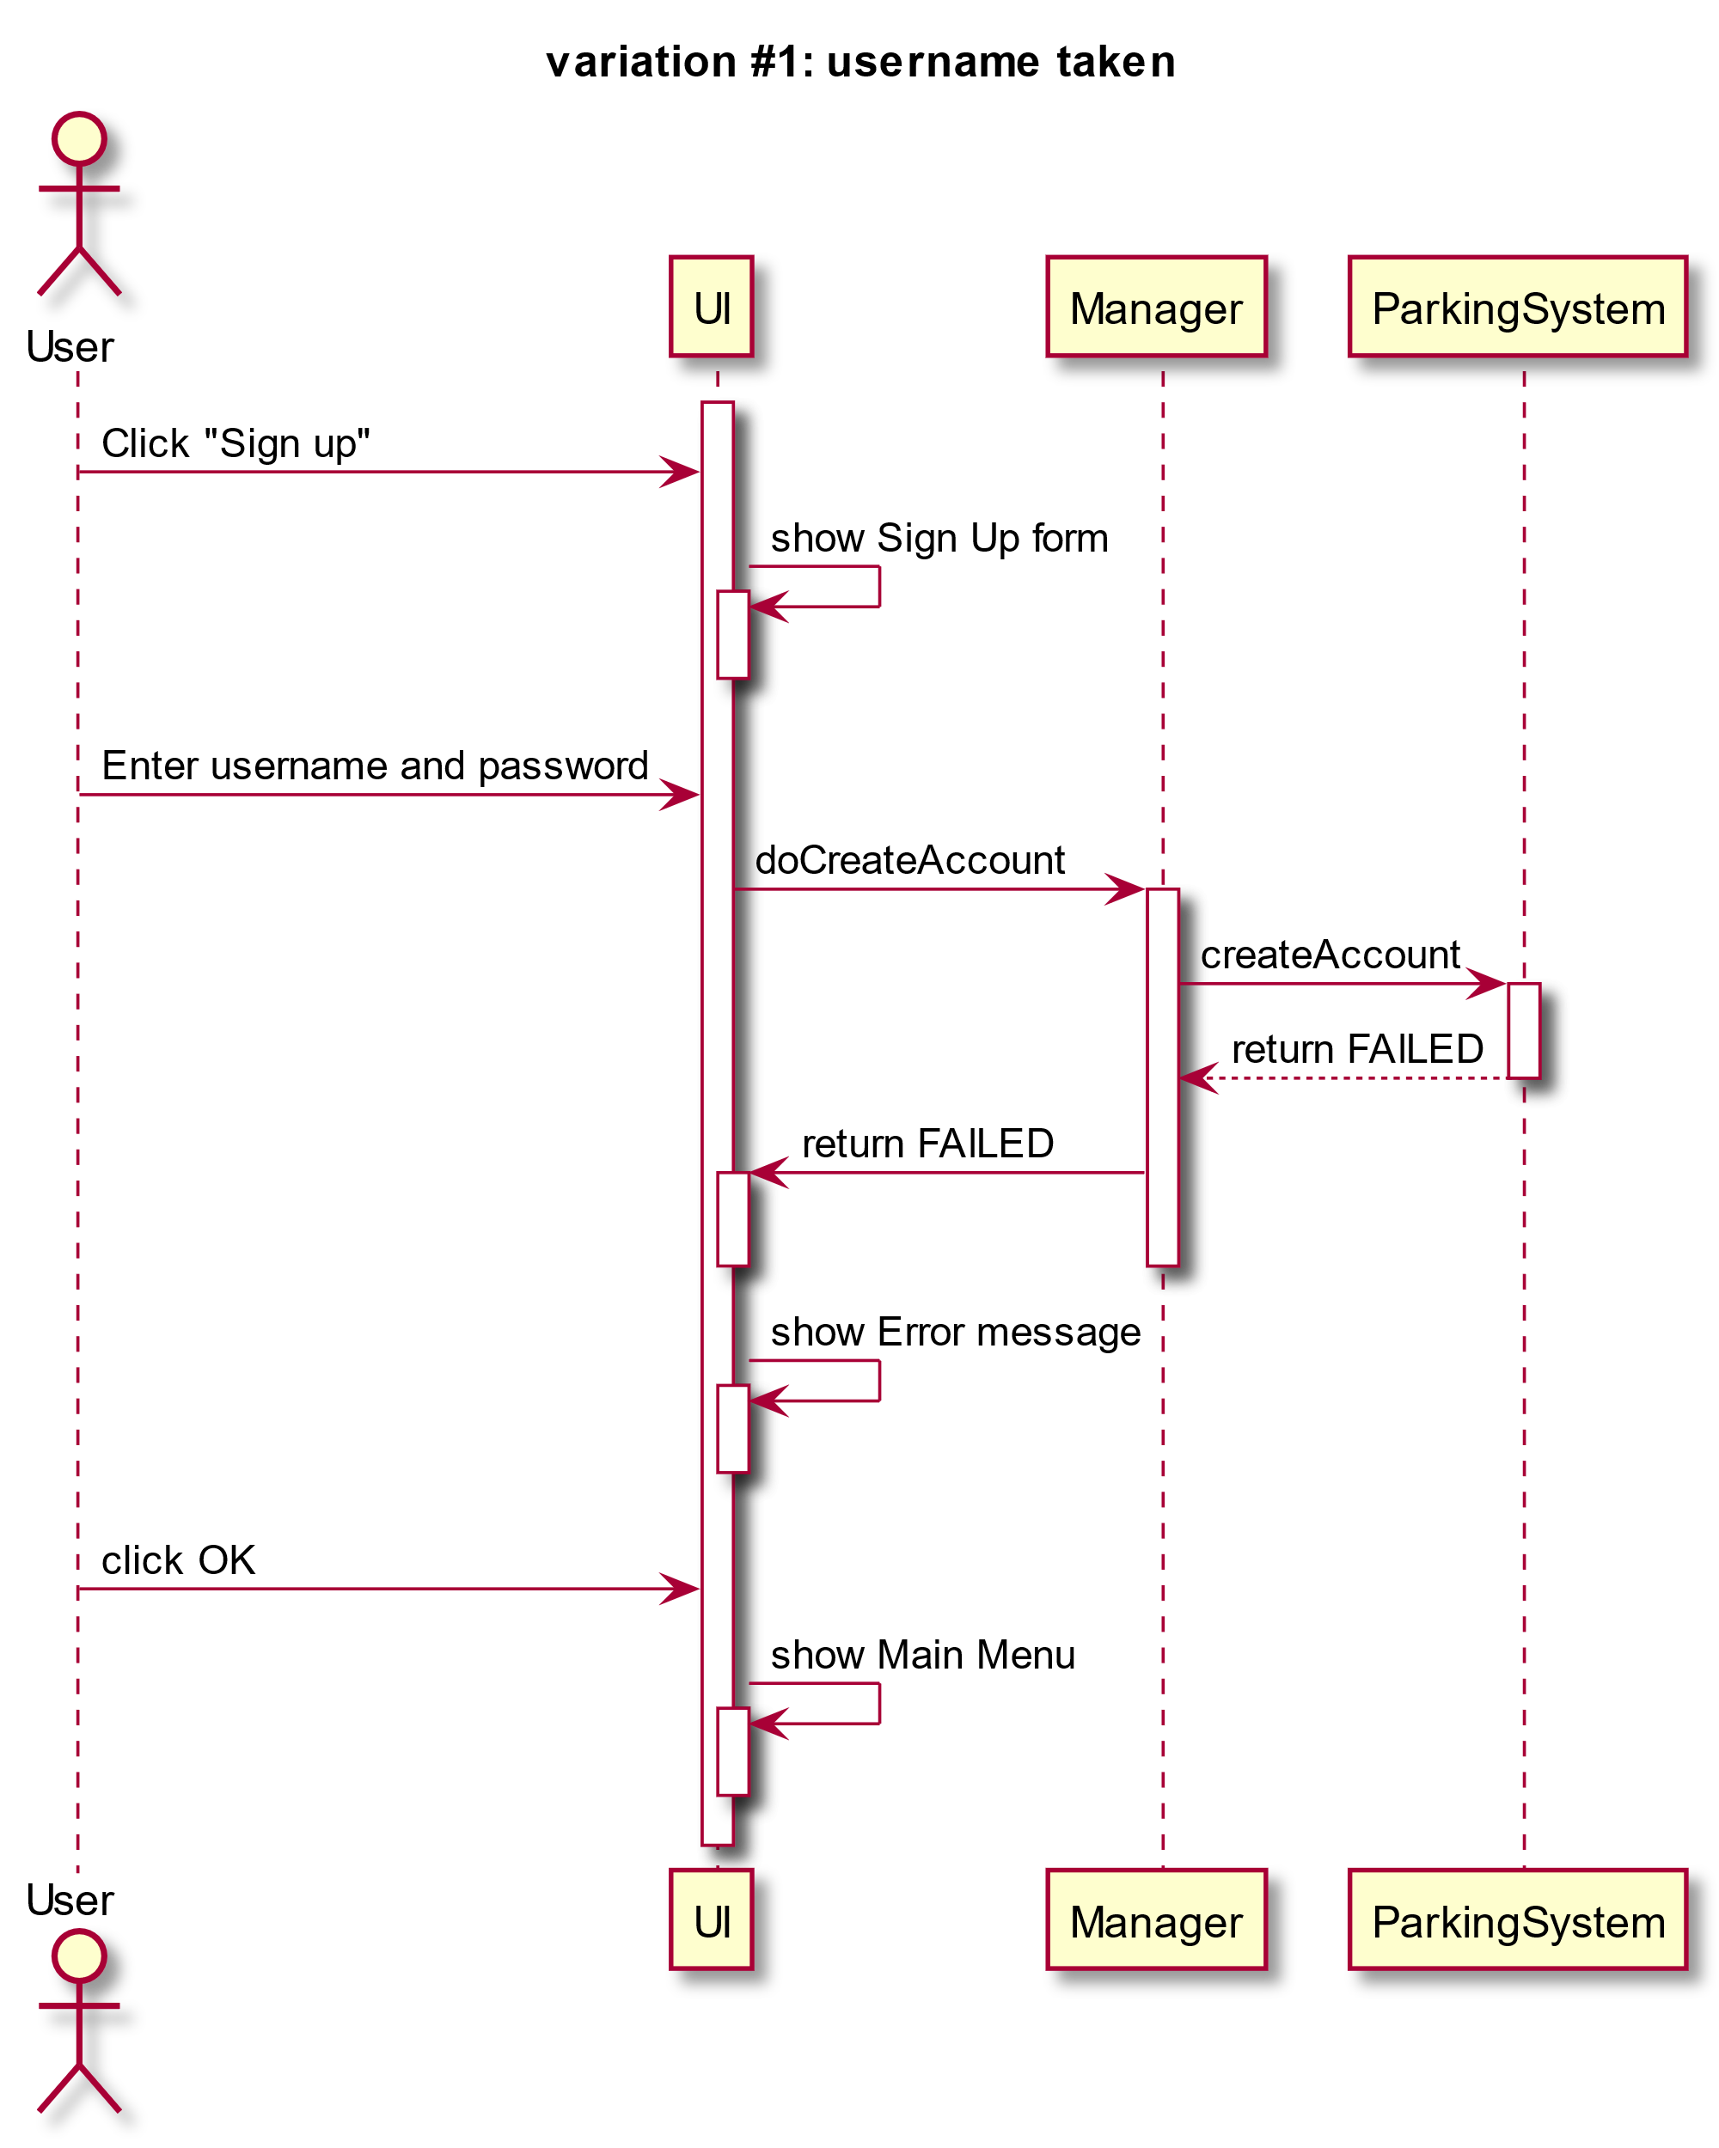

Slide 13
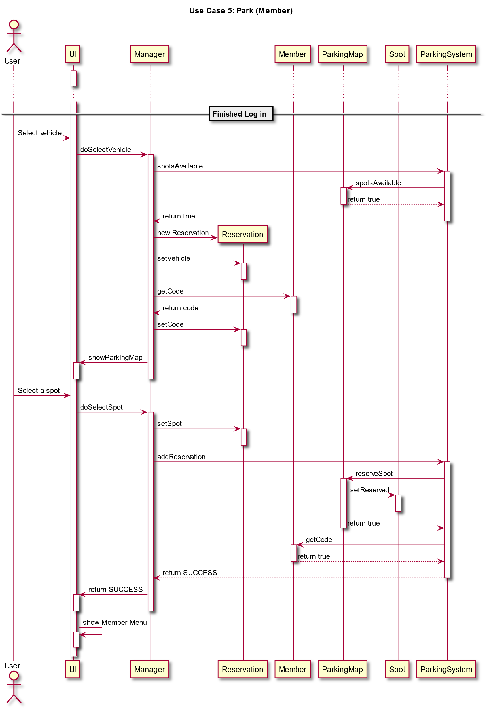

Slide 14
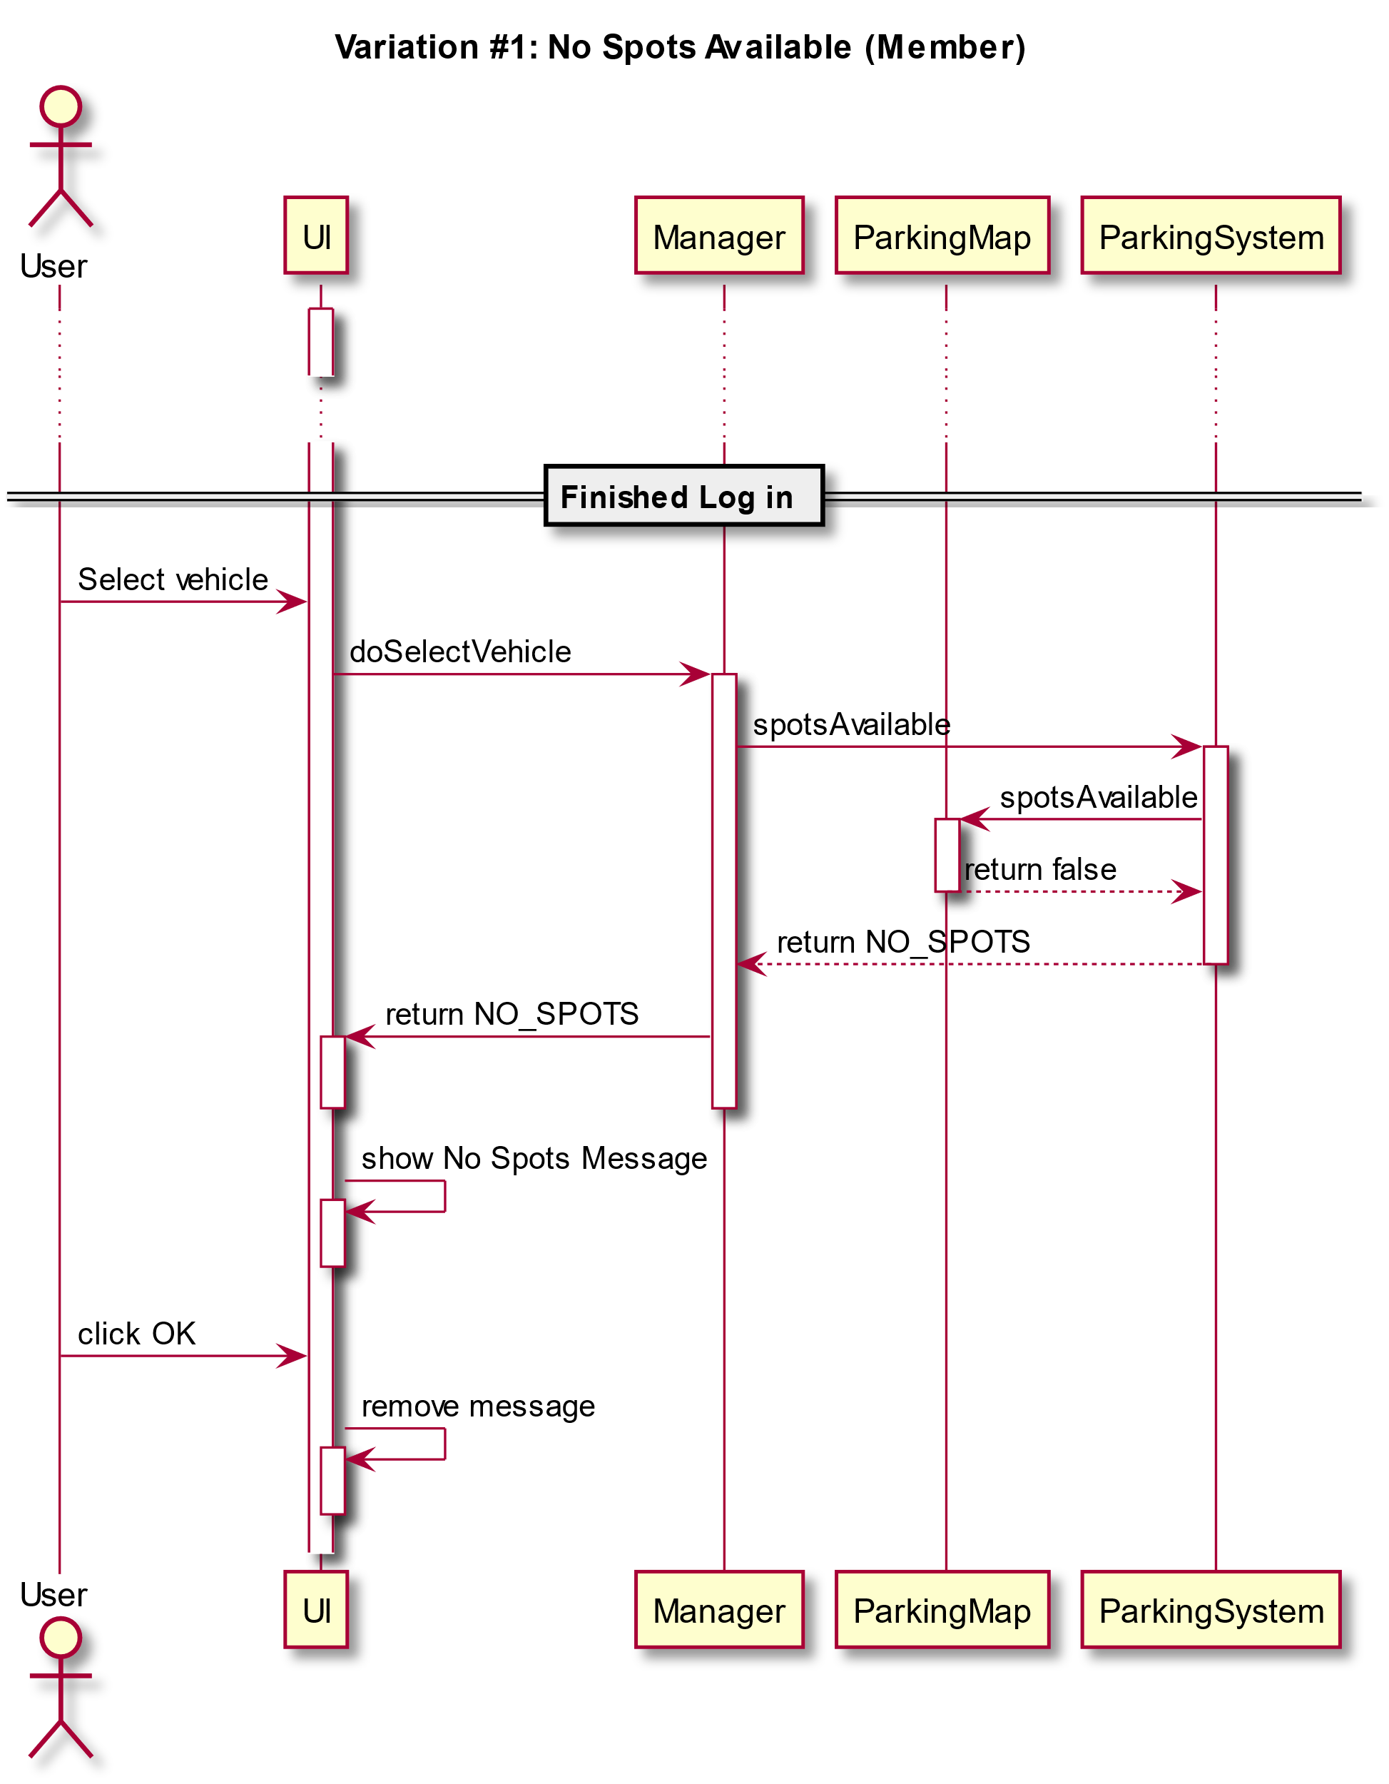

Slide 15
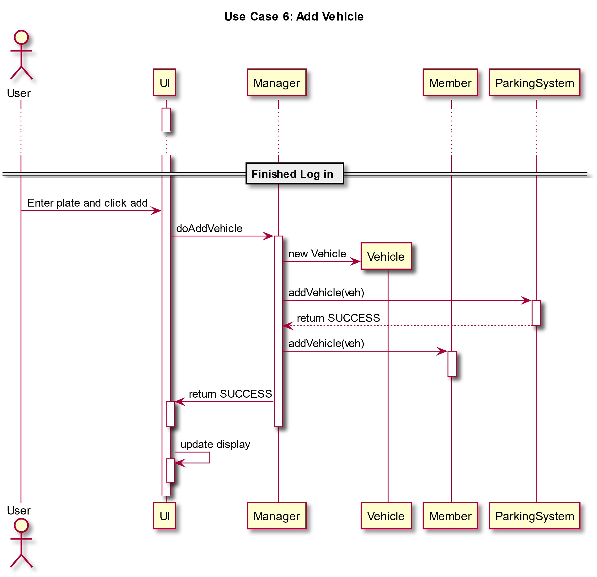

Slide 16
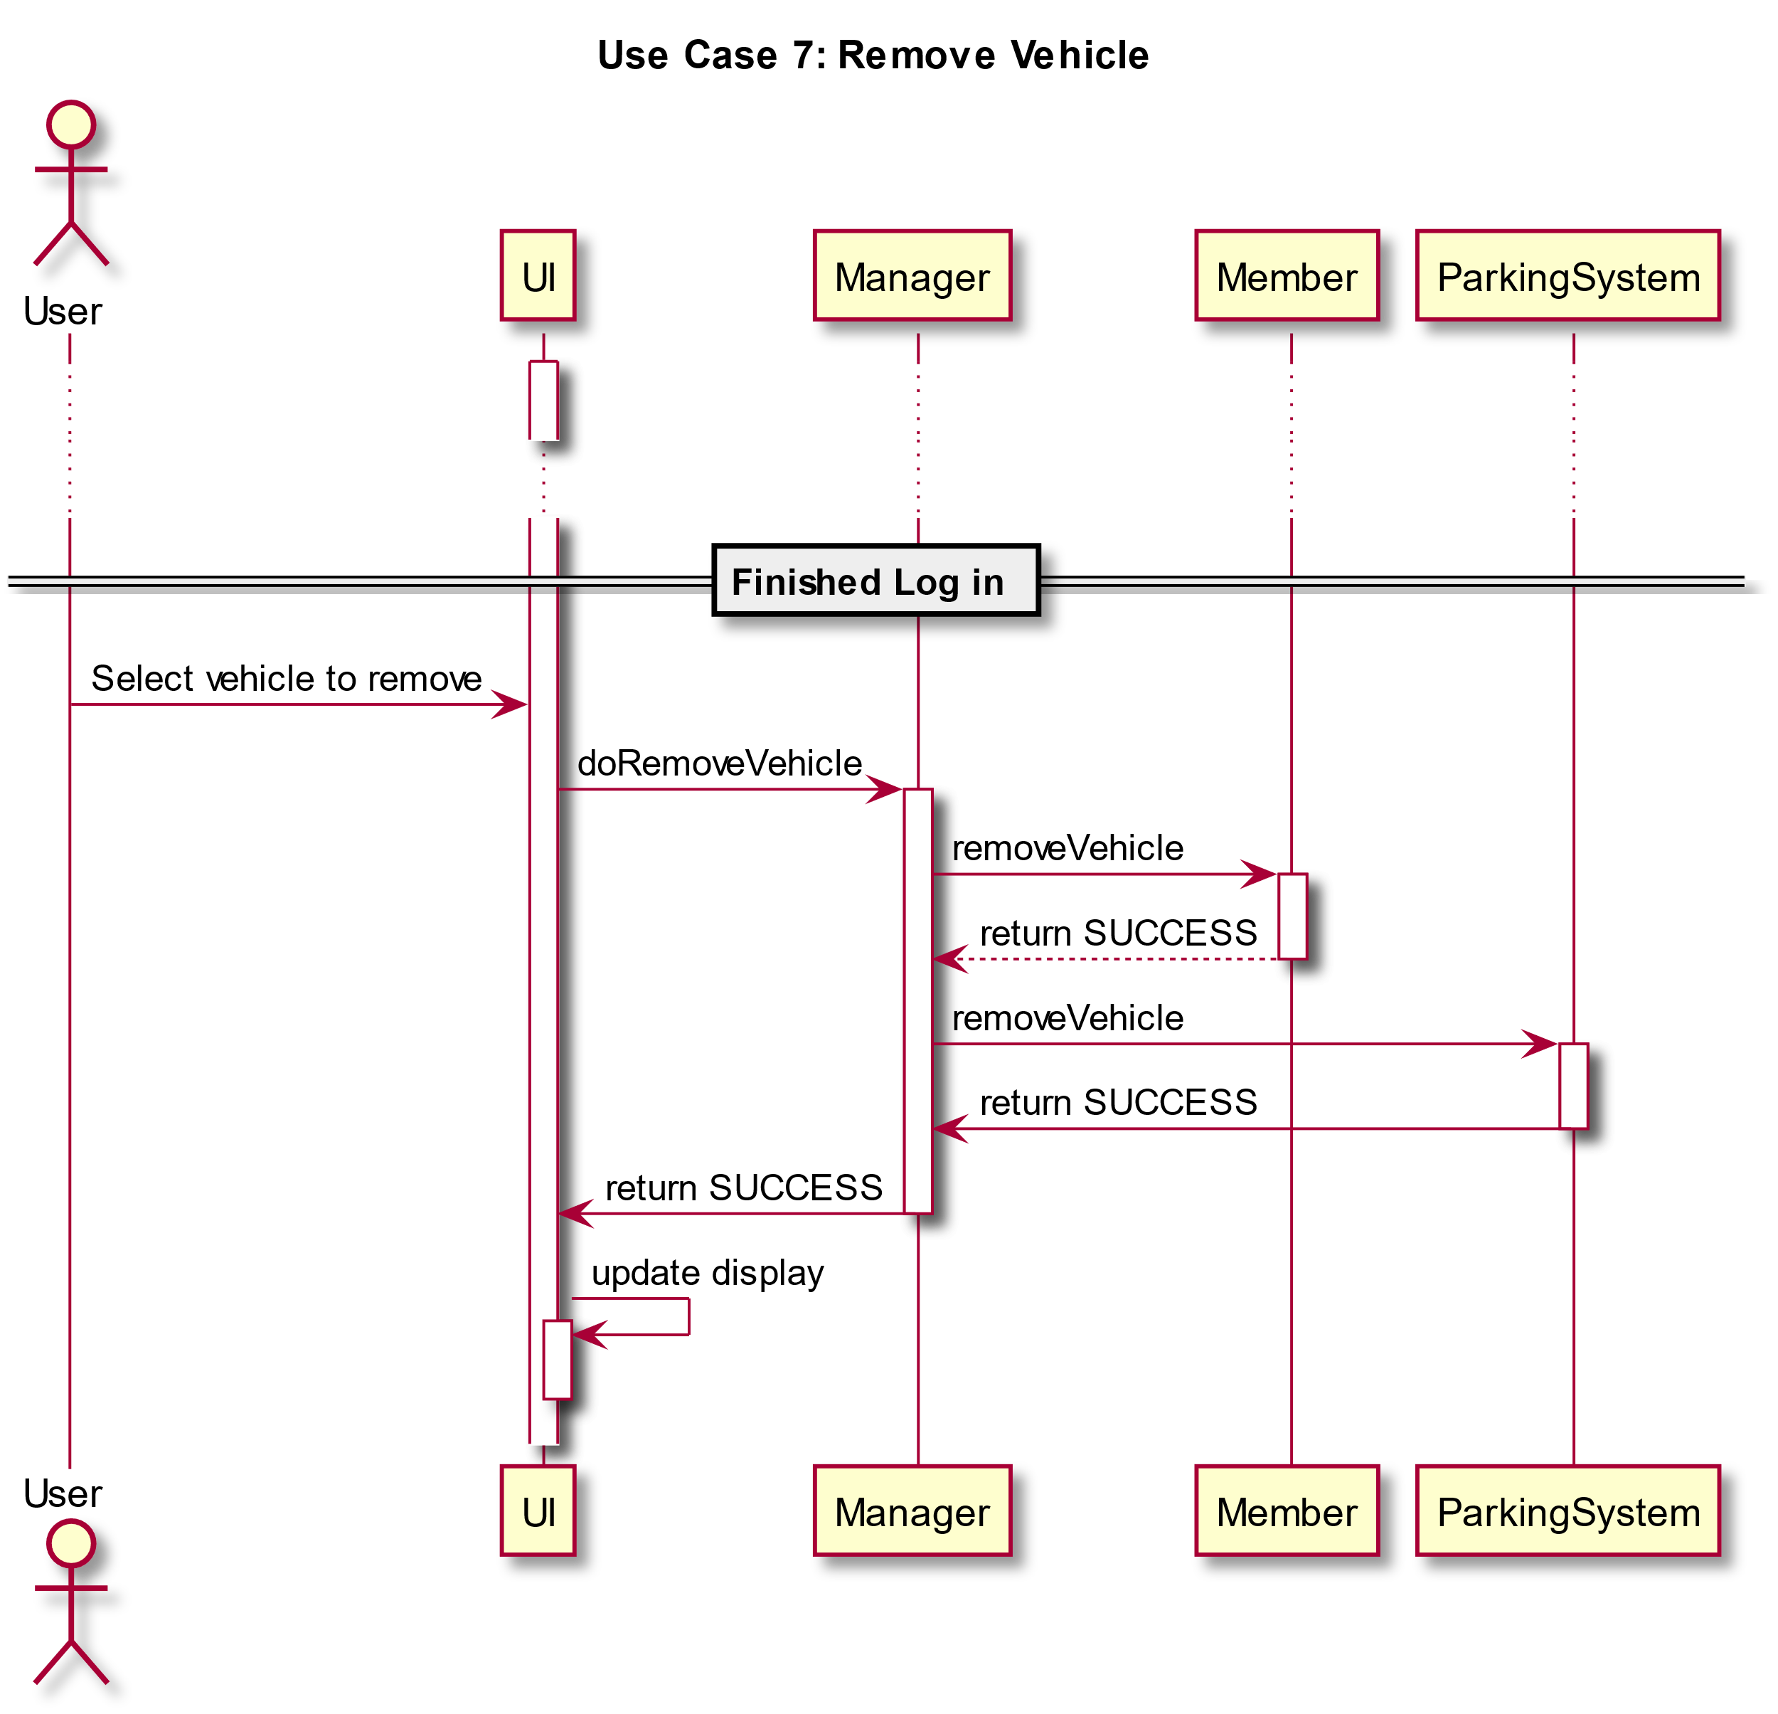

Slide 17
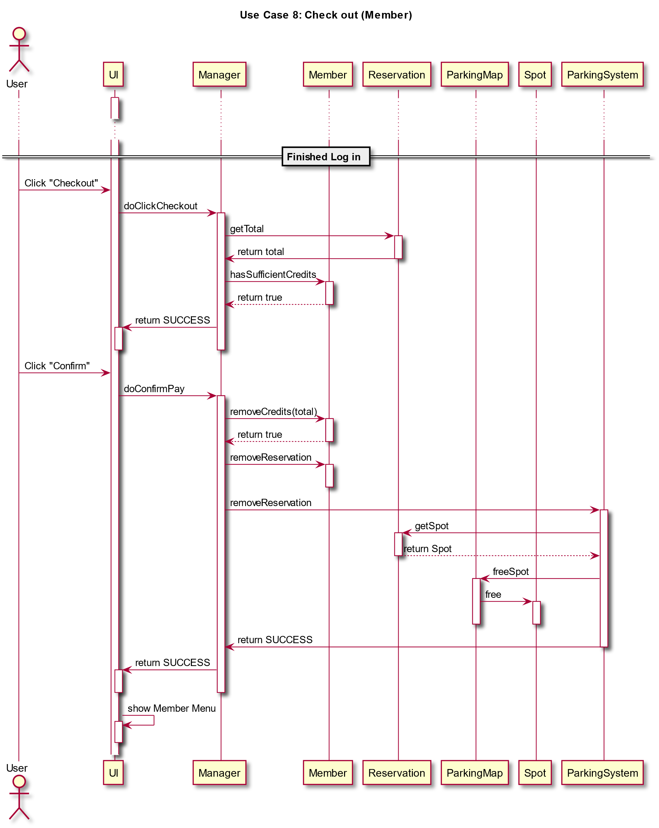

Slide 18
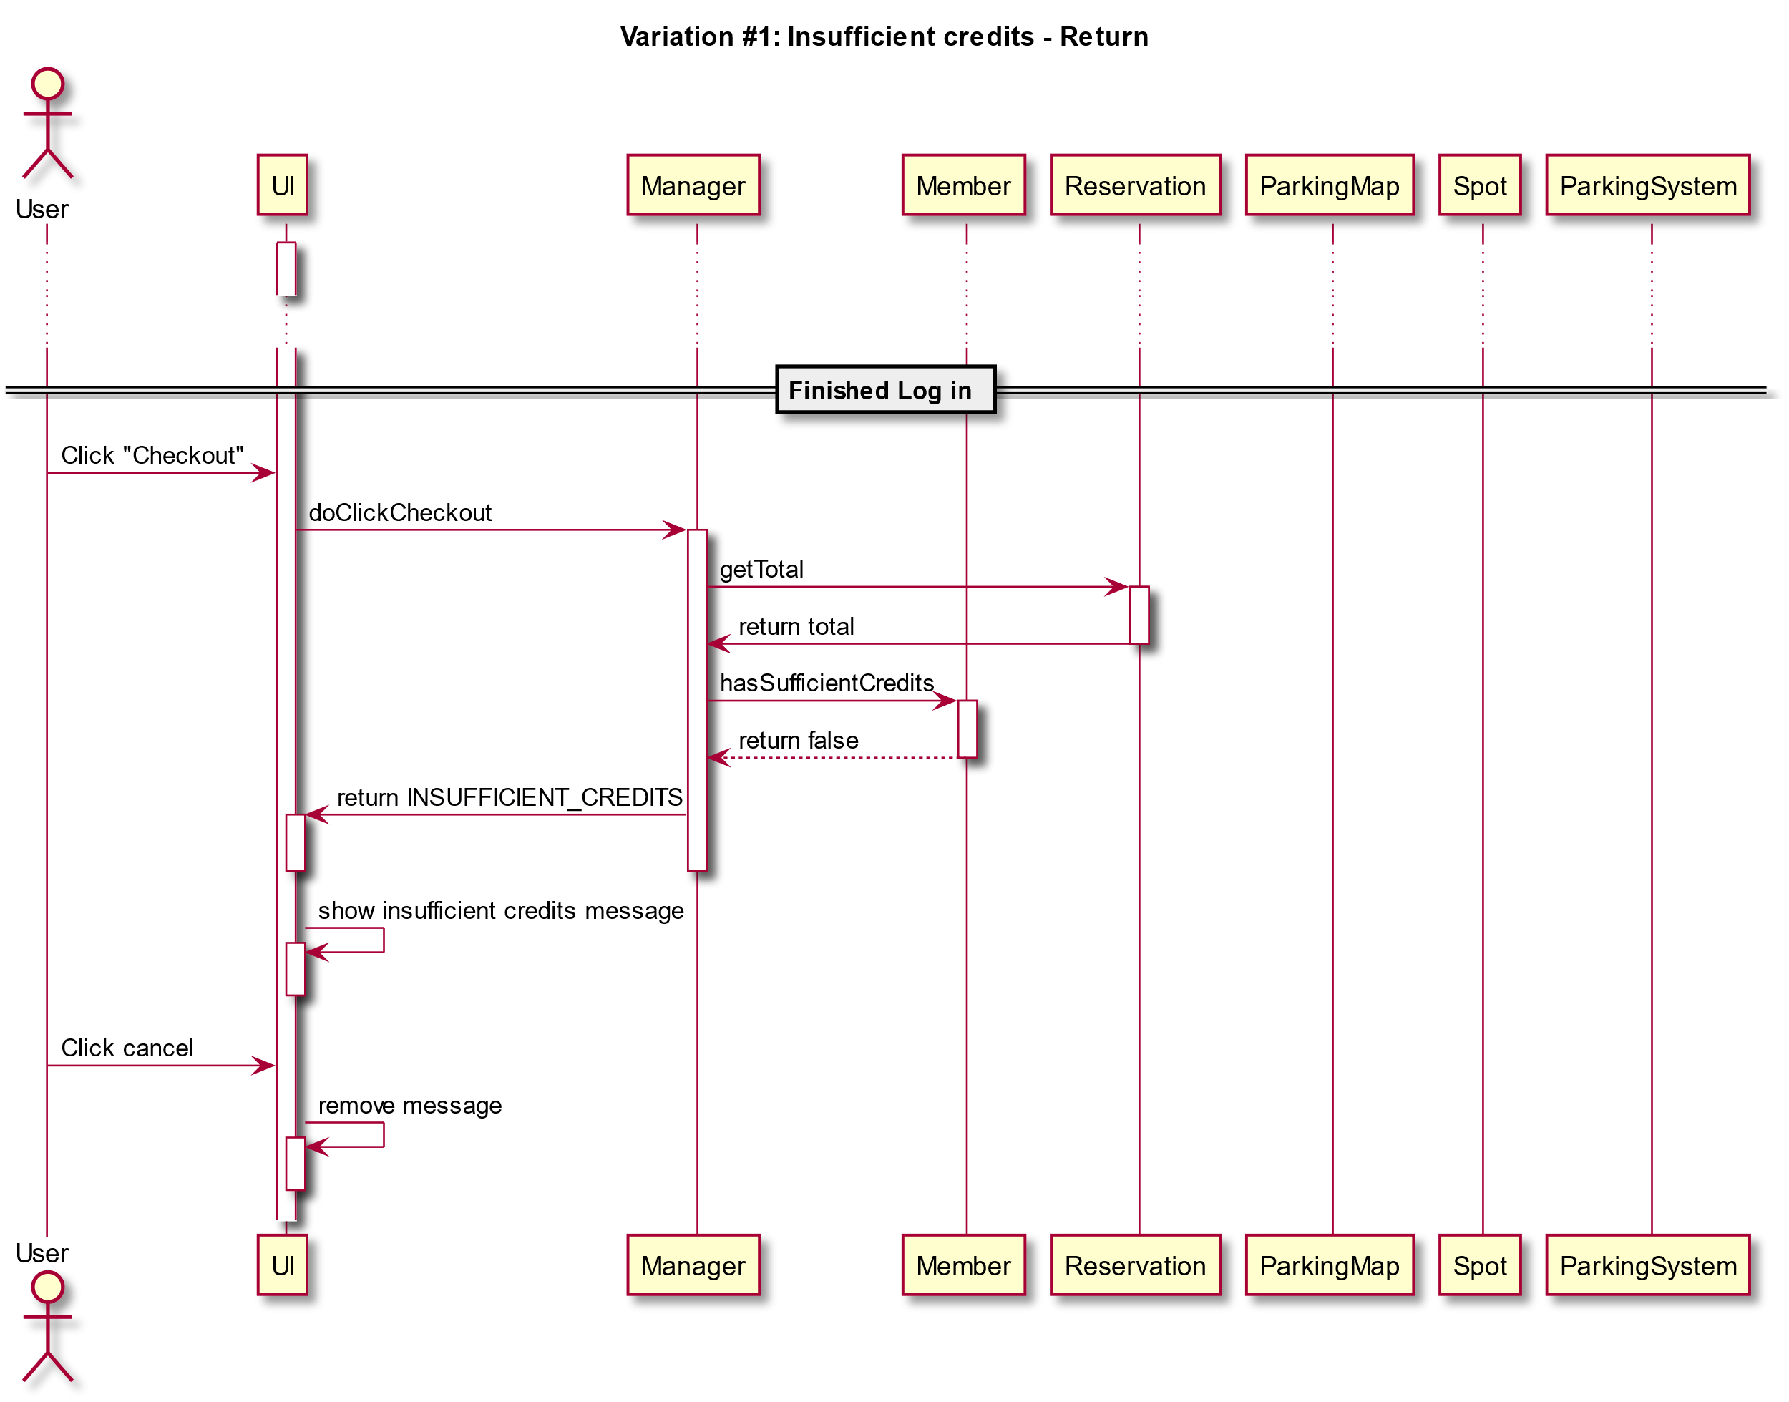

Slide 19
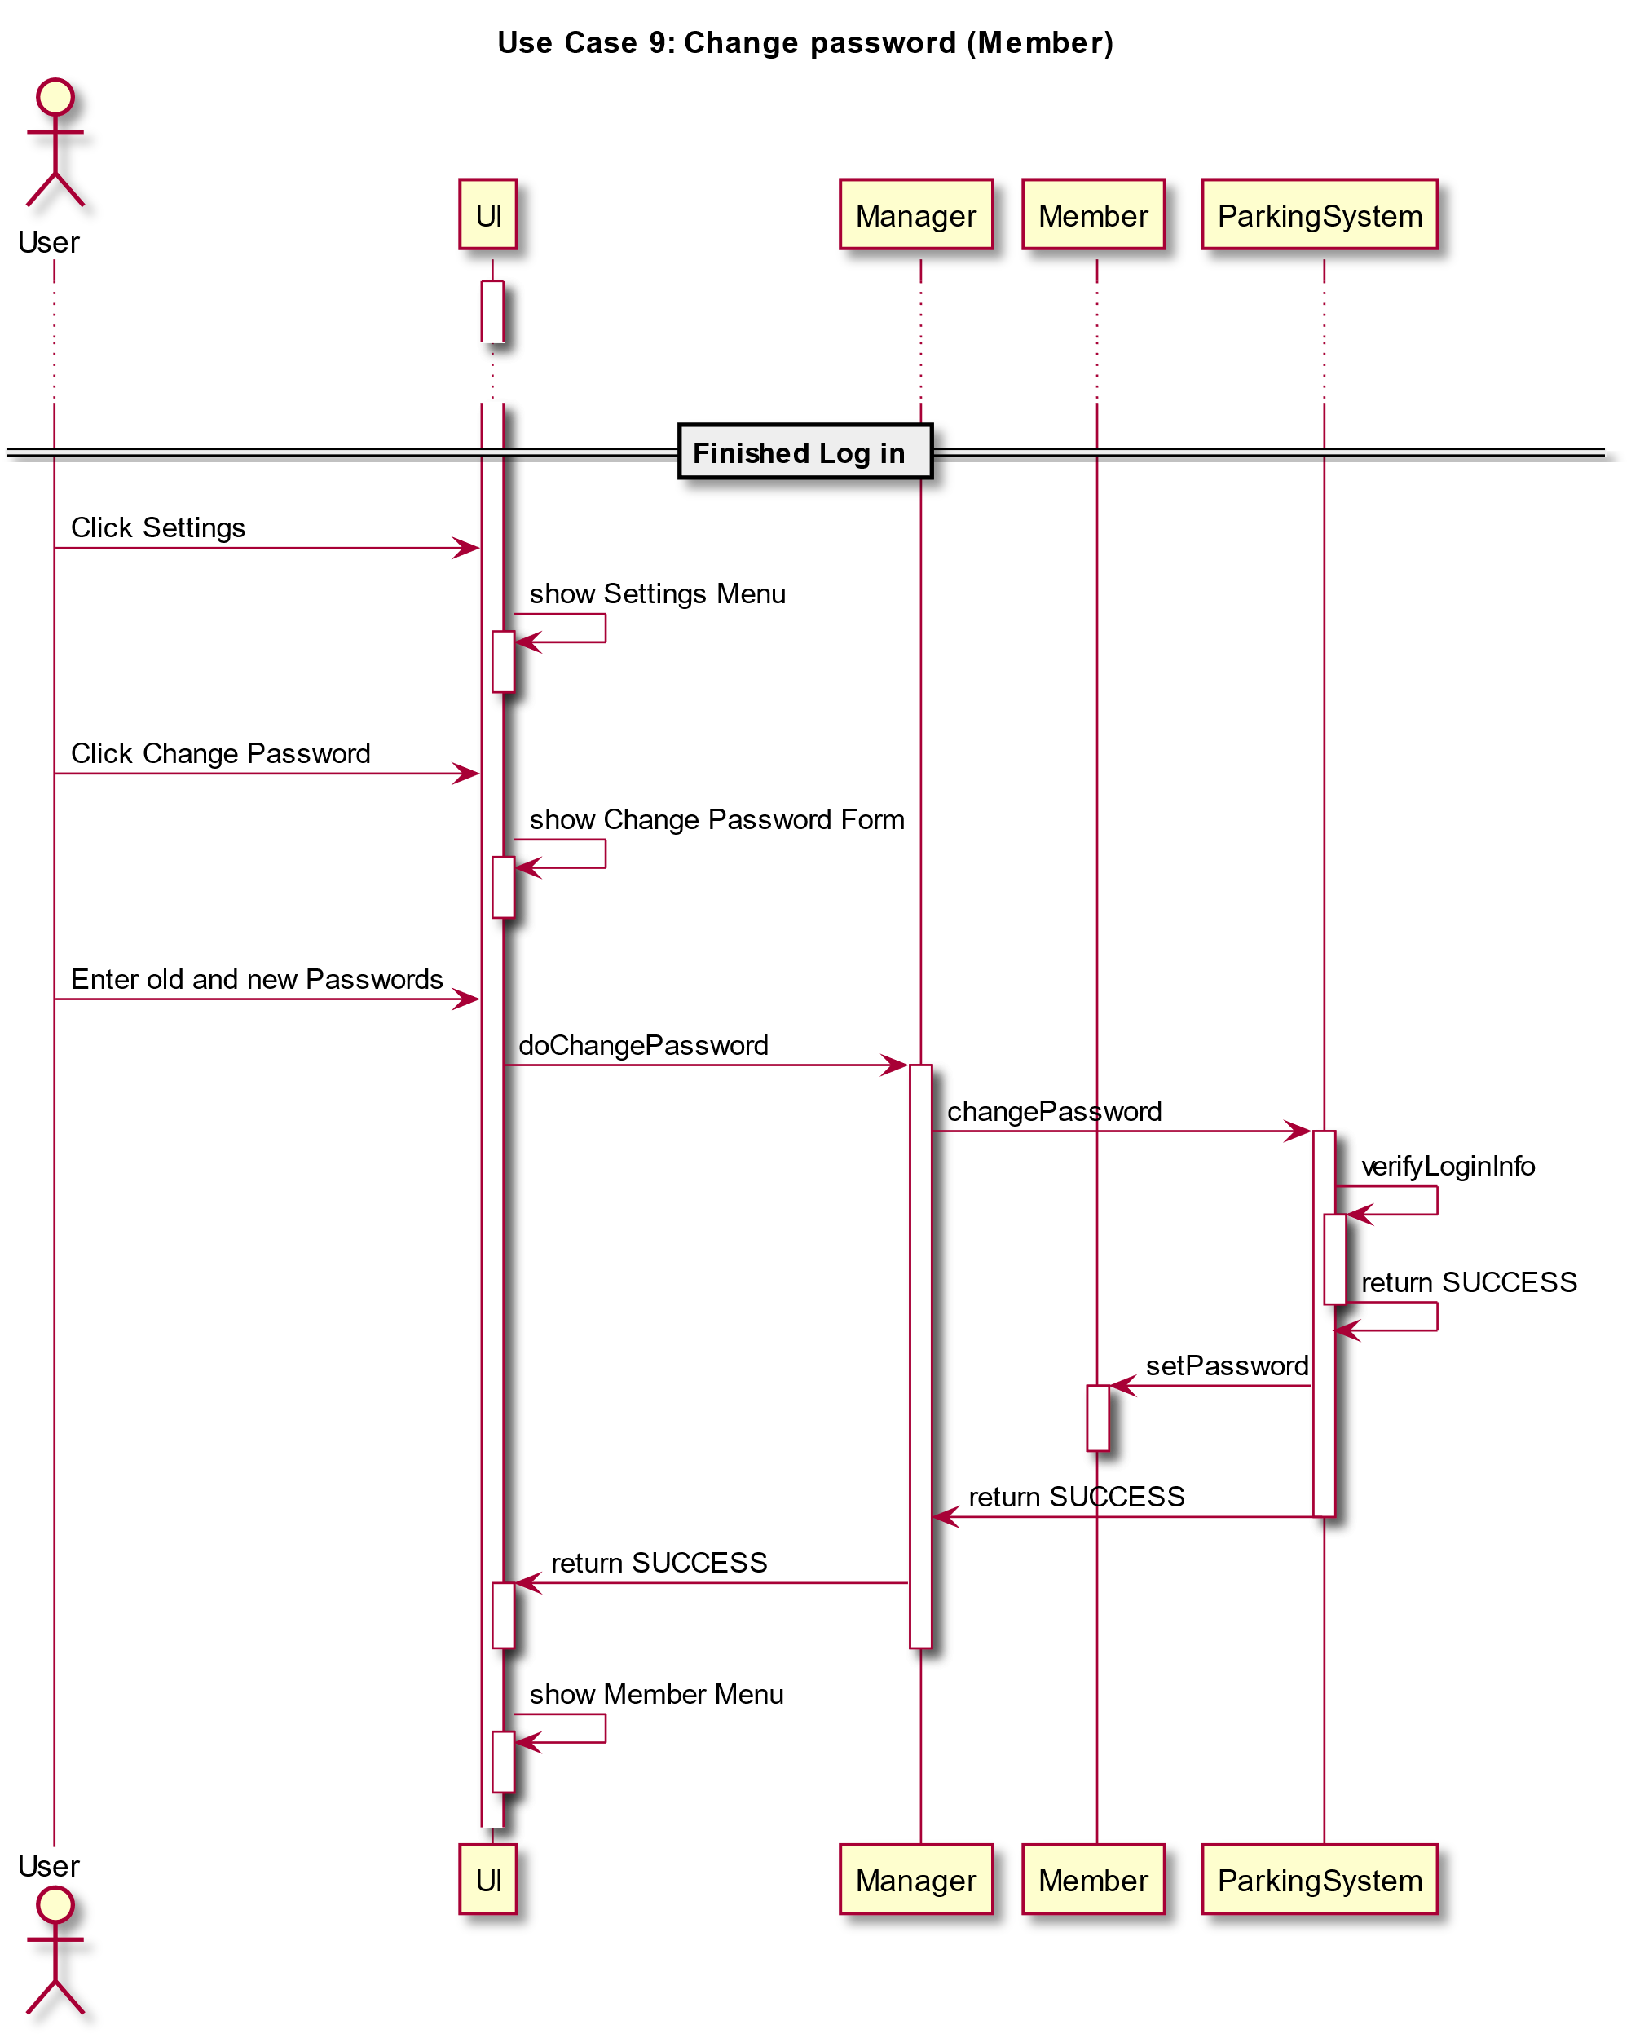

Slide 20
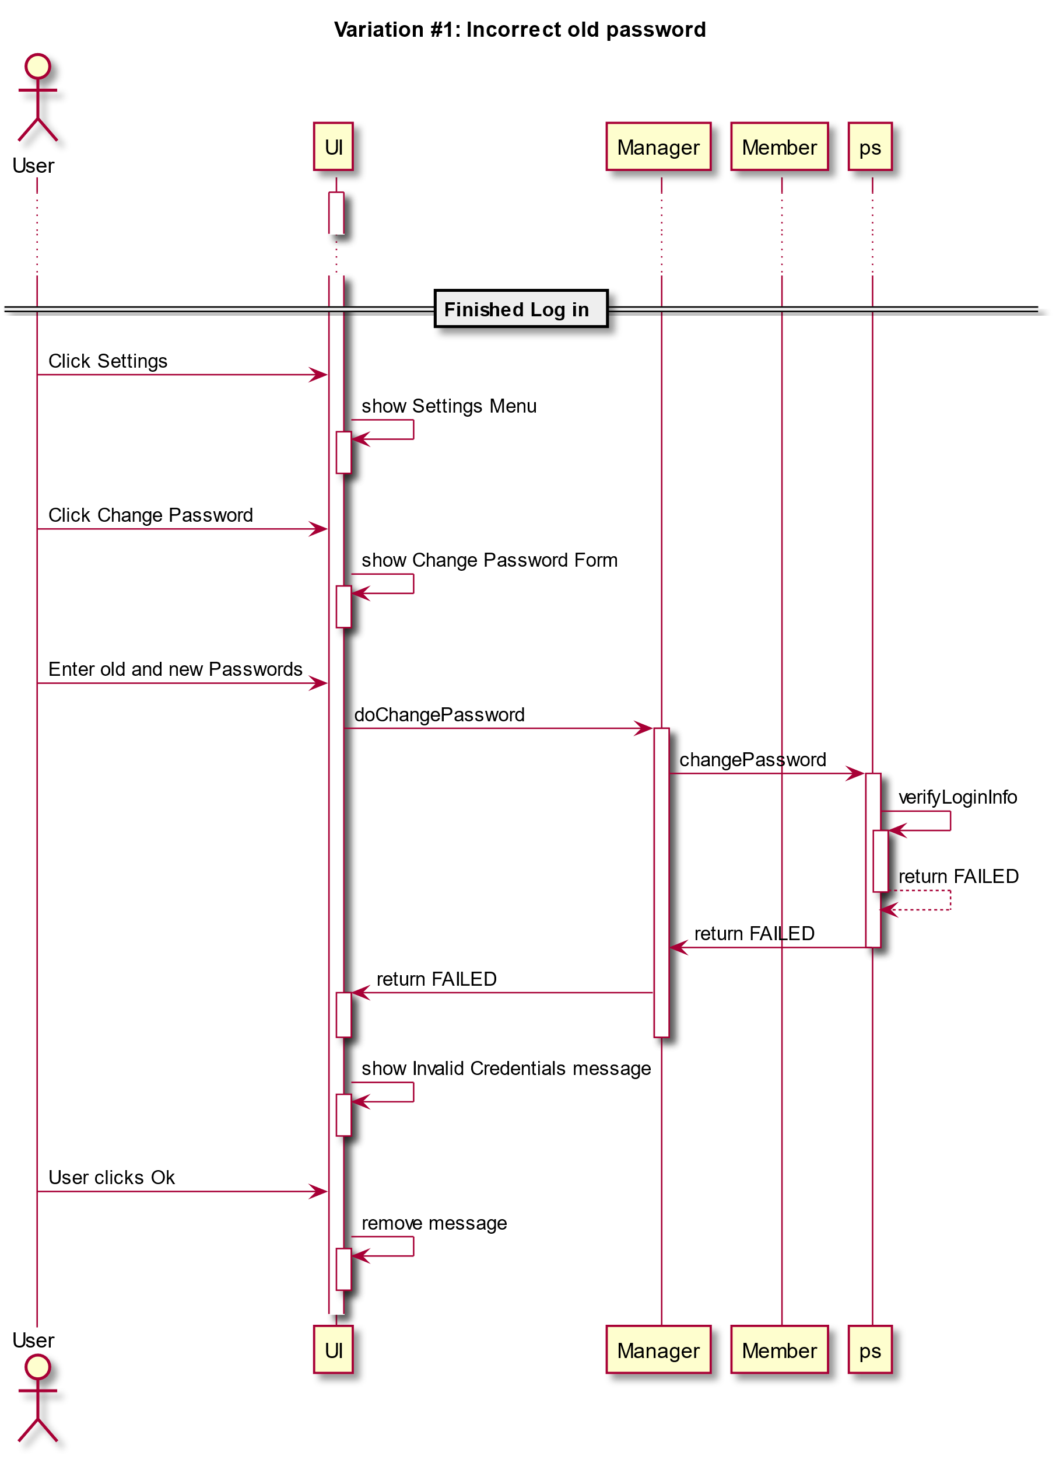

Slide 21
A Learning Experience
GITHUB
Team Collaboration
Efficient division of work load
Tying together front and back end
Use Design Patterns

